Slide 1
Determination of the factors of debt load of the population of Kazakhstan
Kudaibergen Aruzhan
Kaskyrbayev Nurbek
Yerkin Adilet

Slide 2
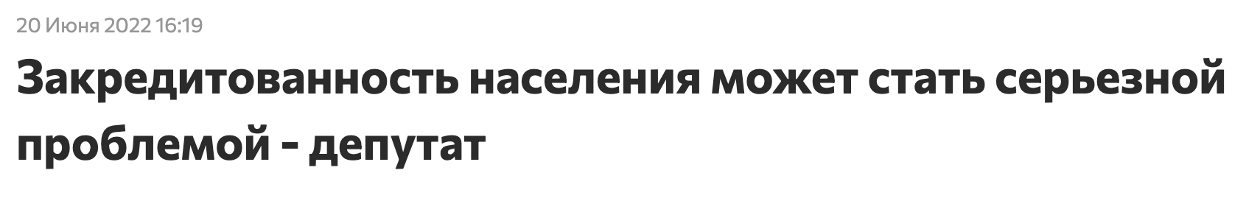
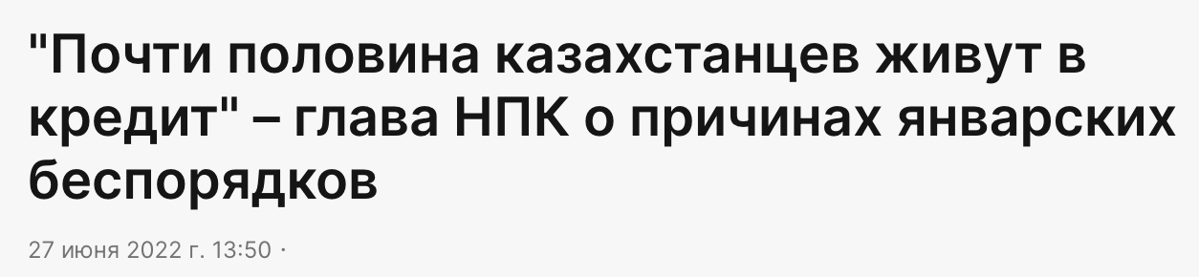
About problem
Last year another 333,000 new borrowers entered the credit system, who had never taken out a loan from a bank before.
The total number of Kazakhstanis with active loans, exceeds 6.5 million people out of a little more than 19 million people in the country.
To date, the retail loan portfolio of Kazakhstan has exceeded 10 trillion tenge. This is almost 43% more than last year.
Almost 6.3 million Kazakhstanis today have outstanding bank loans. Another 1.2 million Kazakhstanis have loans from microfinance organizations
The debt load of Kazakhstanis is growing from year to year !
according to the https://1cb.kz/ February 1, 2022
Notes:
https://kazpravda.kz/n/pochti-polovina-kazahstantsev-zhivut-v-kredit-glava-npk-o-prichinah-yanvarskih-besporyadkov/
https://www.inform.kz/ru/zakreditovannost-naseleniya-mozhet-stat-ser-eznoy-problemoy-deputat_a3946421
https://khabar.kz/ru/news/obshchestvo/item/138488-skolko-kreditov-vydali-kazakhstantsam

Slide 3
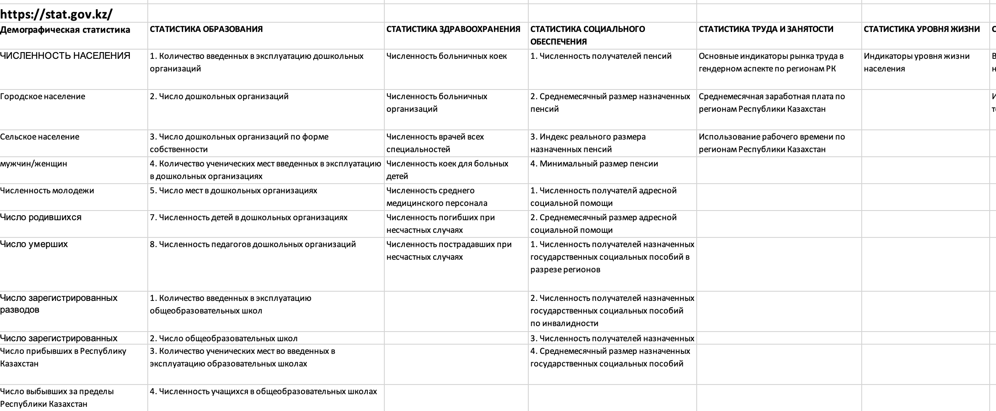
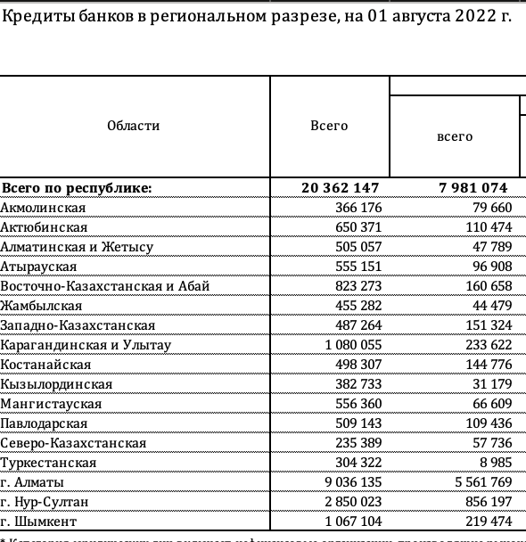
About dataset
Dataset consists data from https://stat.gov.kz, https://www.nationalbank.kz. Statistical data from 2012 to 2022 until July for every month.
There are 10 years (*12 month), 17 regions
60 columns from different sphere
https://stat.gov.kz
https://www.nationalbank.kz

Slide 4
Hypotheses
Hypotheses 1
Hypotheses 2
Hypotheses 3
Item 3
social changes affect debt load
With a decrease in the standard of living of the population, the debt load is growing
Increasing in the number of registered marriages has a positive effect on the increase in debt load
External factors like inflation, exchange rates
The number of recipients of assigned state social benefits for disability (for the loss of the breadwinner)
Average monthly salary by regions of the Republic of Kazakhstan
have a negative effect on the increase in debt load

Slide 5
Steps to the solution
Data collection / preprocessing from different source of data (historical data)
Make analysis
Try to find related patterns (correlation) that leads to the over debt load of population
Suggestion for debt reduction

